Slide 2
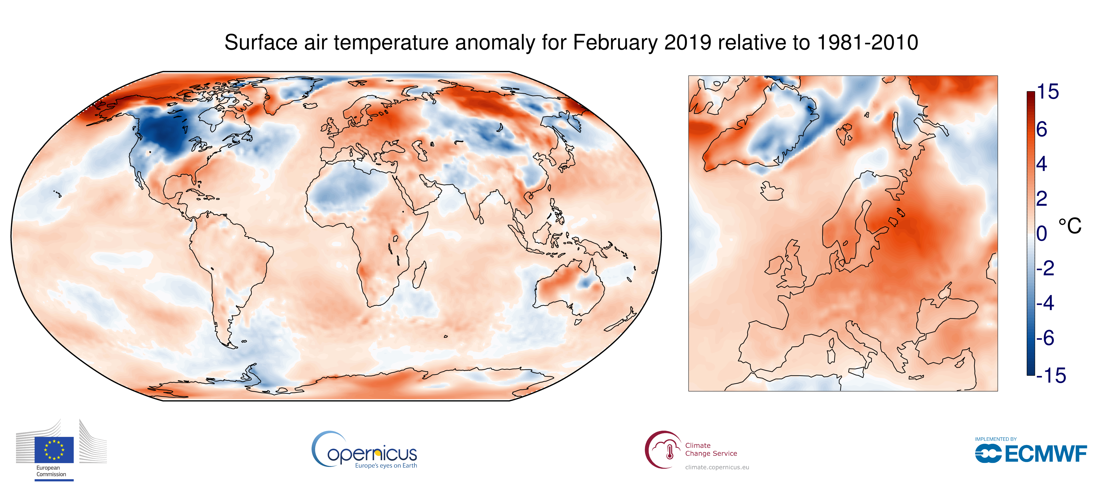
Synthetic Fuels in Sustainable Energy Systems
Robert Schlögl
Fritz-Haber-Institut, Berlin
MPI CEC, Mülheim,
www.solarify.de

Slide 3
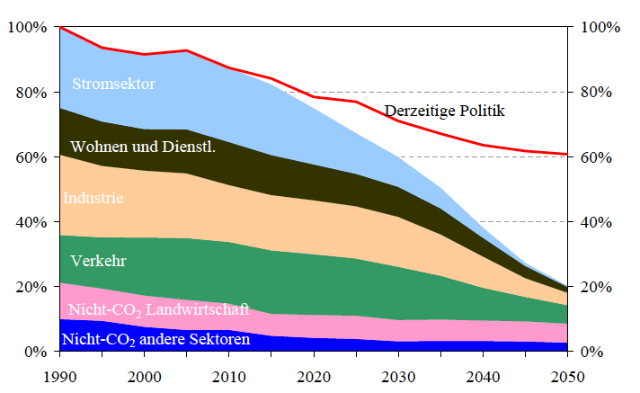
EU targets and mobility
EU targets require massive reductions of CO₂ emissions.
Mobility is left with an only 50% reduction target due to its diffuse emission character.
Mobility is the third largest CO₂ emitter. It has not contributed to CO₂ reduction during the past 20 years despite regulations on efficiency and fleet emission.
Source
Eurostat (2017)

Slide 4
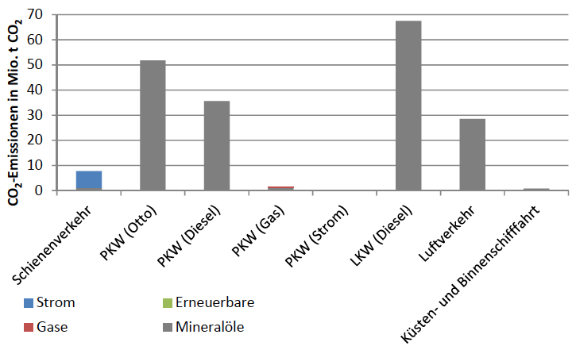
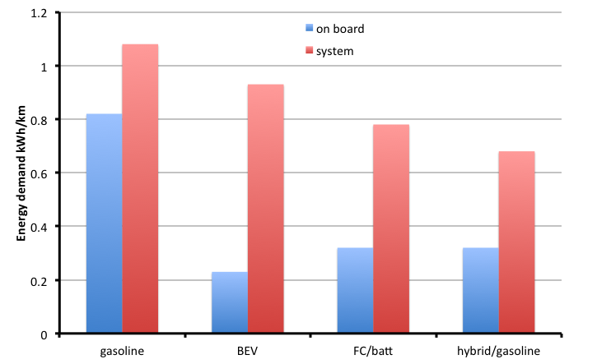
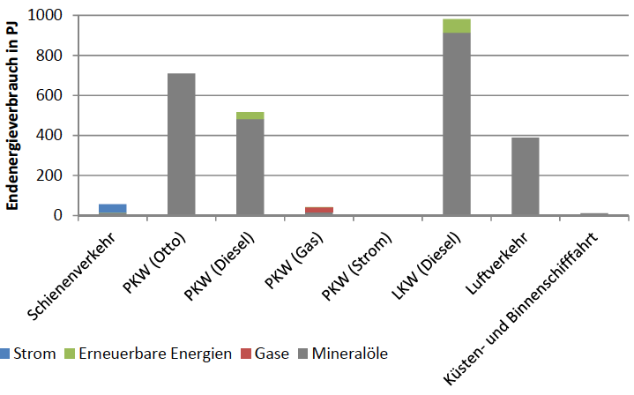
Mobility in D
If the tank to wheel energy consumption of all mobility can be reduced to 50 % from now (mainly in the PKW sector)…
Source: DECHEMA PtX (2018)
GinaBella et al (2017)
And the traction energy gets a 25% syn fuel discount on CO₂ emission ….
Then the EU target of ca. 50% mobility emission can be reached

Slide 5
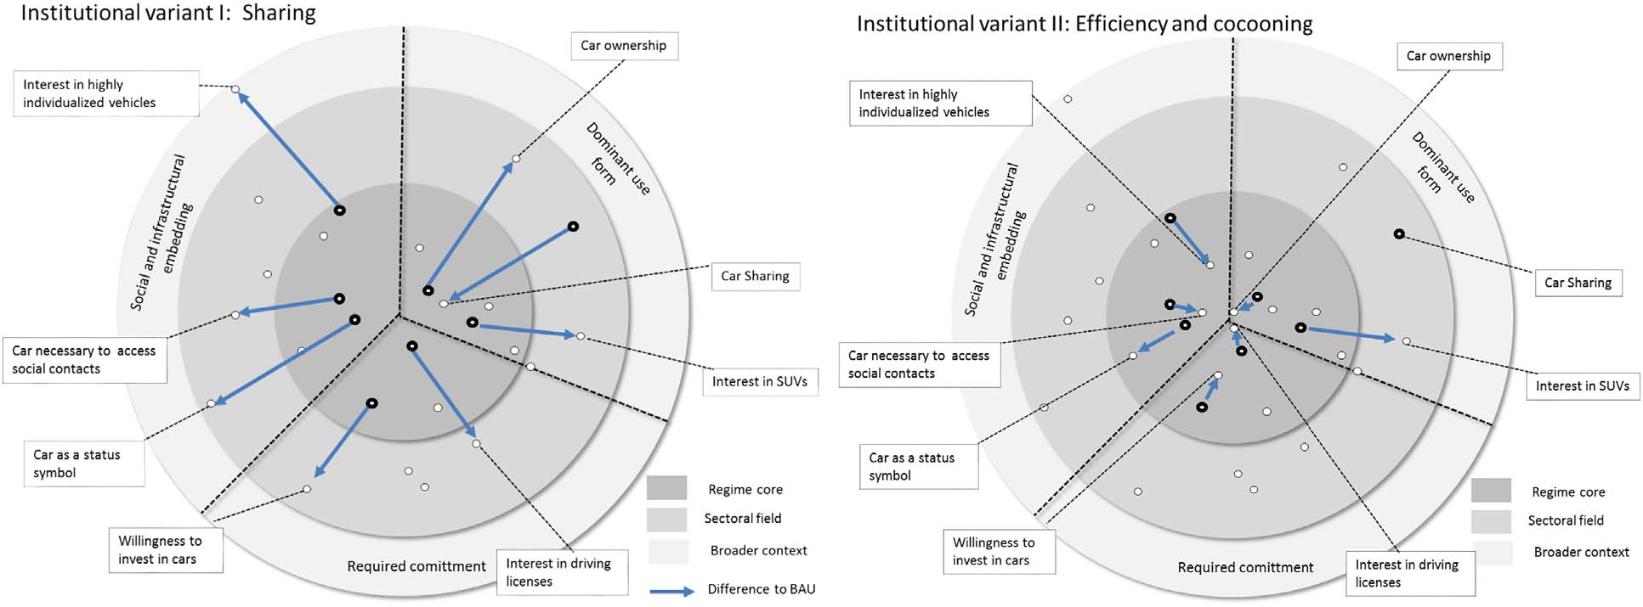
Mobility can be organized differently…
Truffer et al. Technological Forecasting & Social Change 122 (2017) 34–48
How much mobility in what modality is needed in the future?

Slide 6
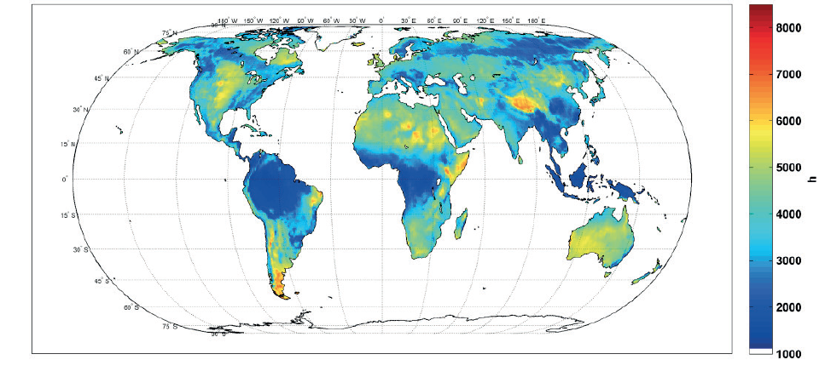
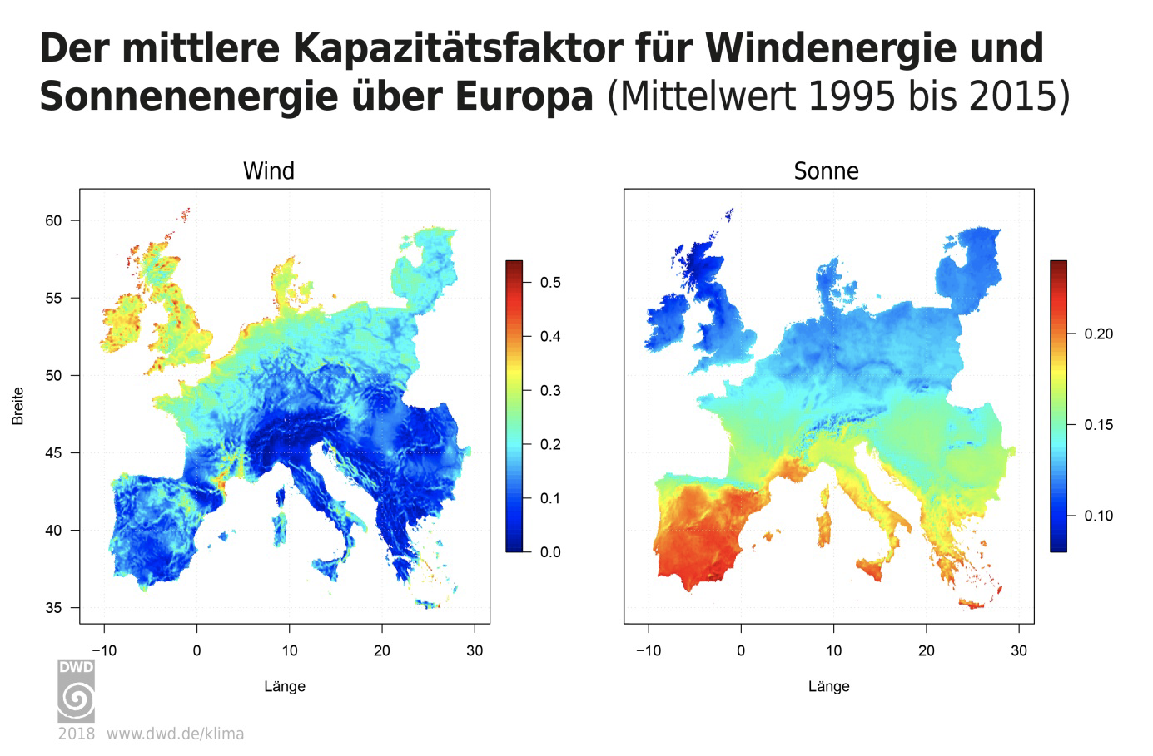
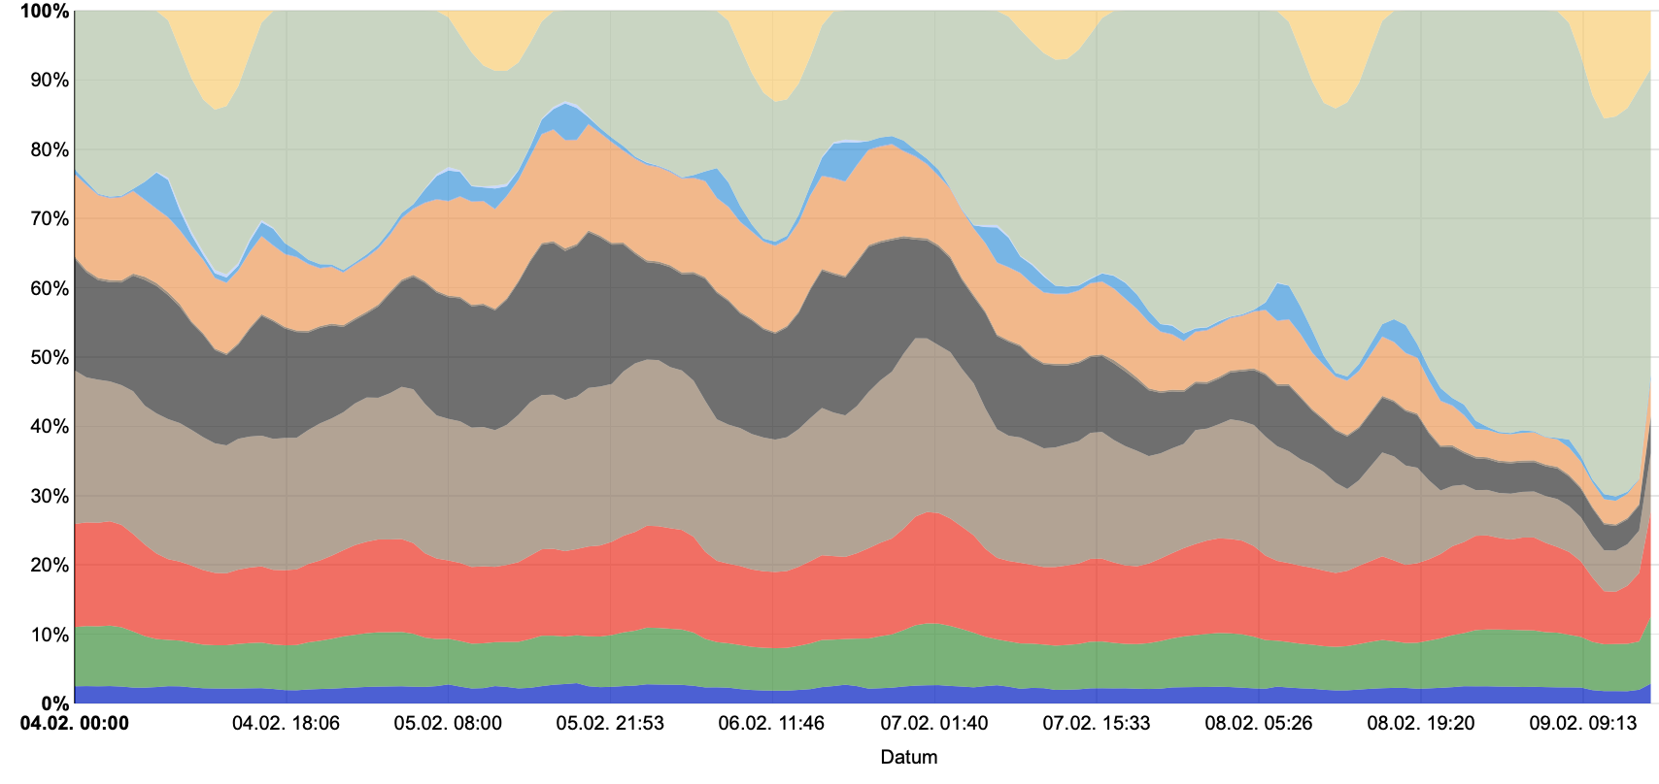
Local Renewables cannot supply directly all energy needed in most populated areas: Transport and storage essential
RES is without conversion losses; in relation to thermal energy 40% of RES give the same amount of electricity.
When storage is necessary to bridge the lack of immediate RES the efficiency drops largely (by a factor of 4) and requires thus respective resources.
It is wise to omit the de-facto concept of local RES and design future energy systems with large amounts of transportable RES replacing present fossil fuel transports.
Quelle
ISE Februar 2019
IEA (2017)
Renewables

Slide 7
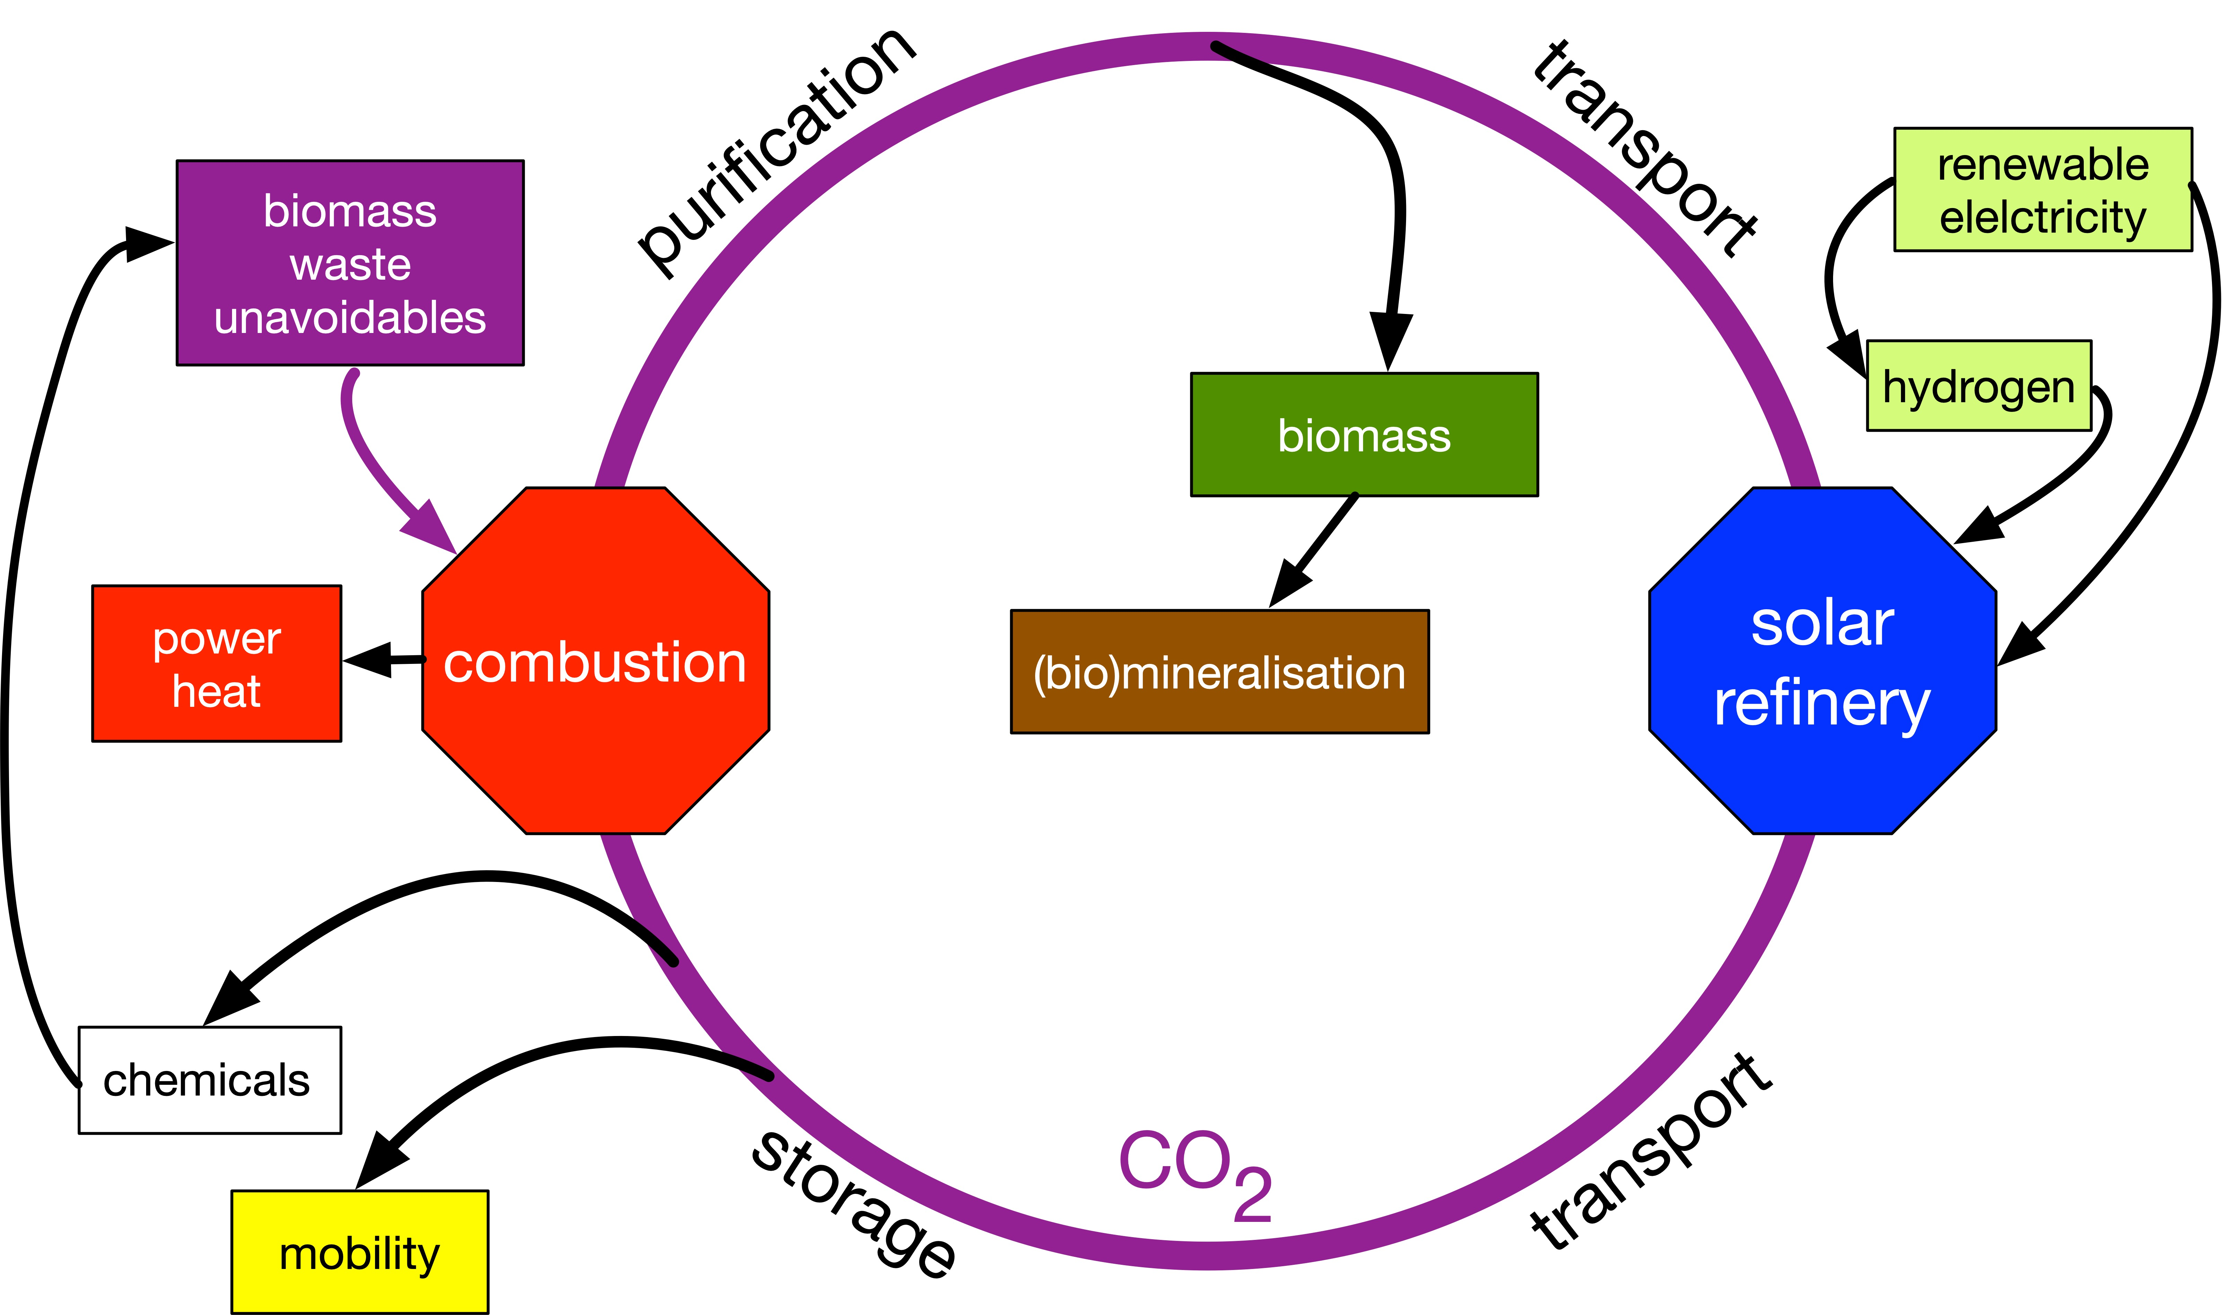
The technical carbon cycle
The missing amount of energy not available locally from RES is supplied from storage and transportation preferably from regions with excess RES.
The technical carbon cycle allows using the existing fossil transportation infrastructure.
The structure of the cycle is hierarchical (global, regional, national) as today the fossil transport structure.

Slide 8
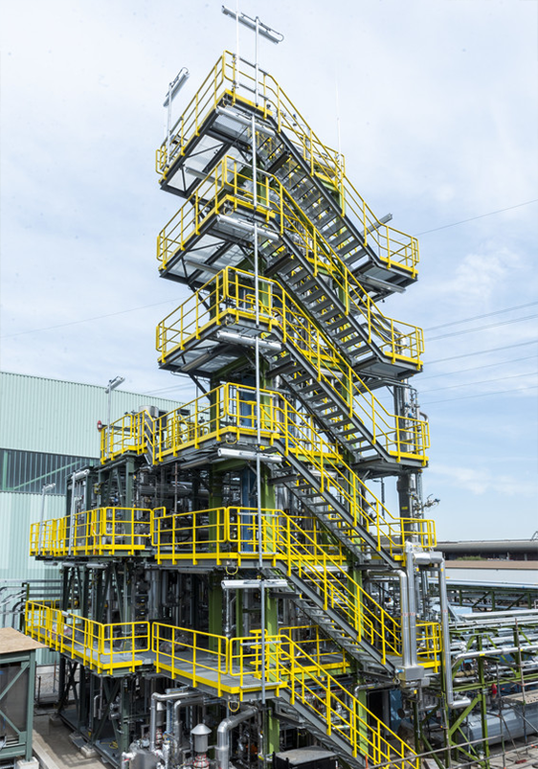
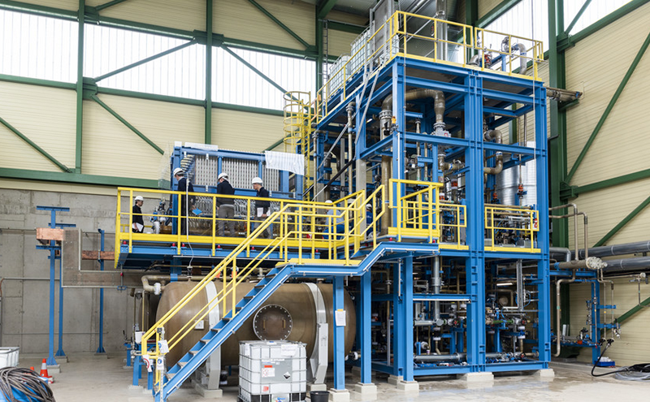
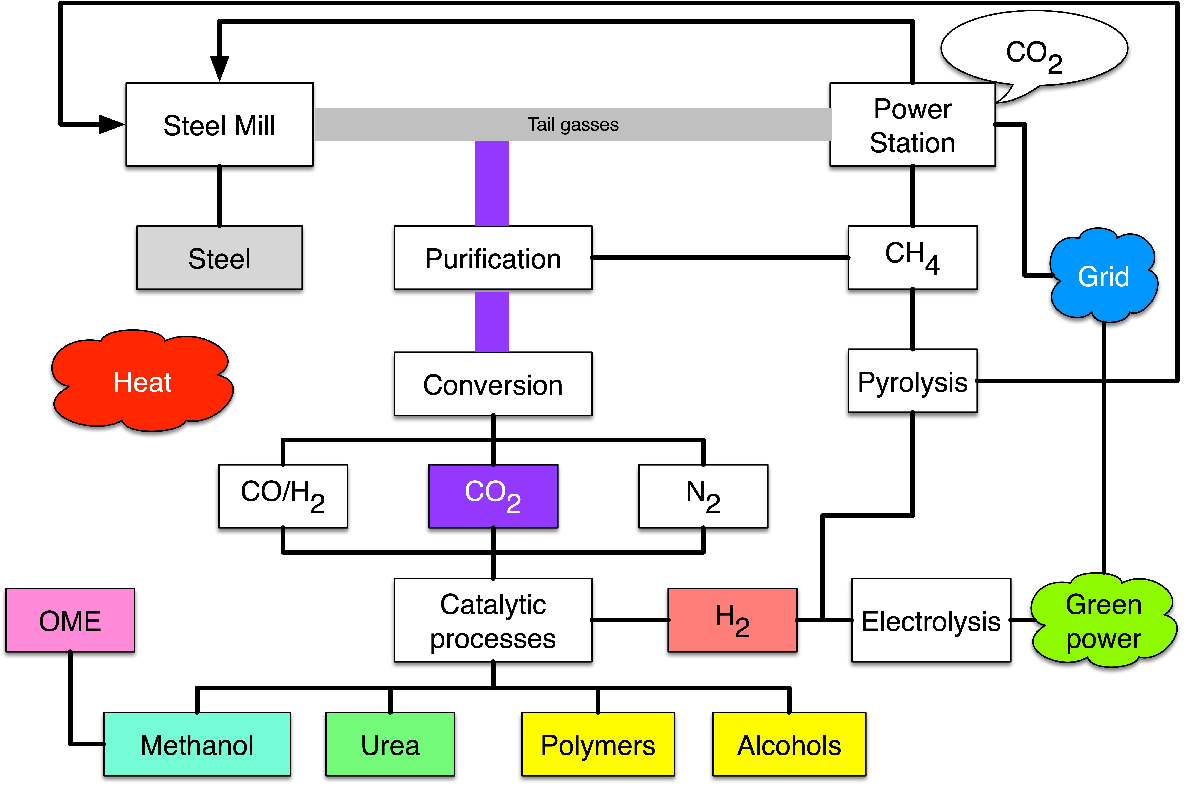
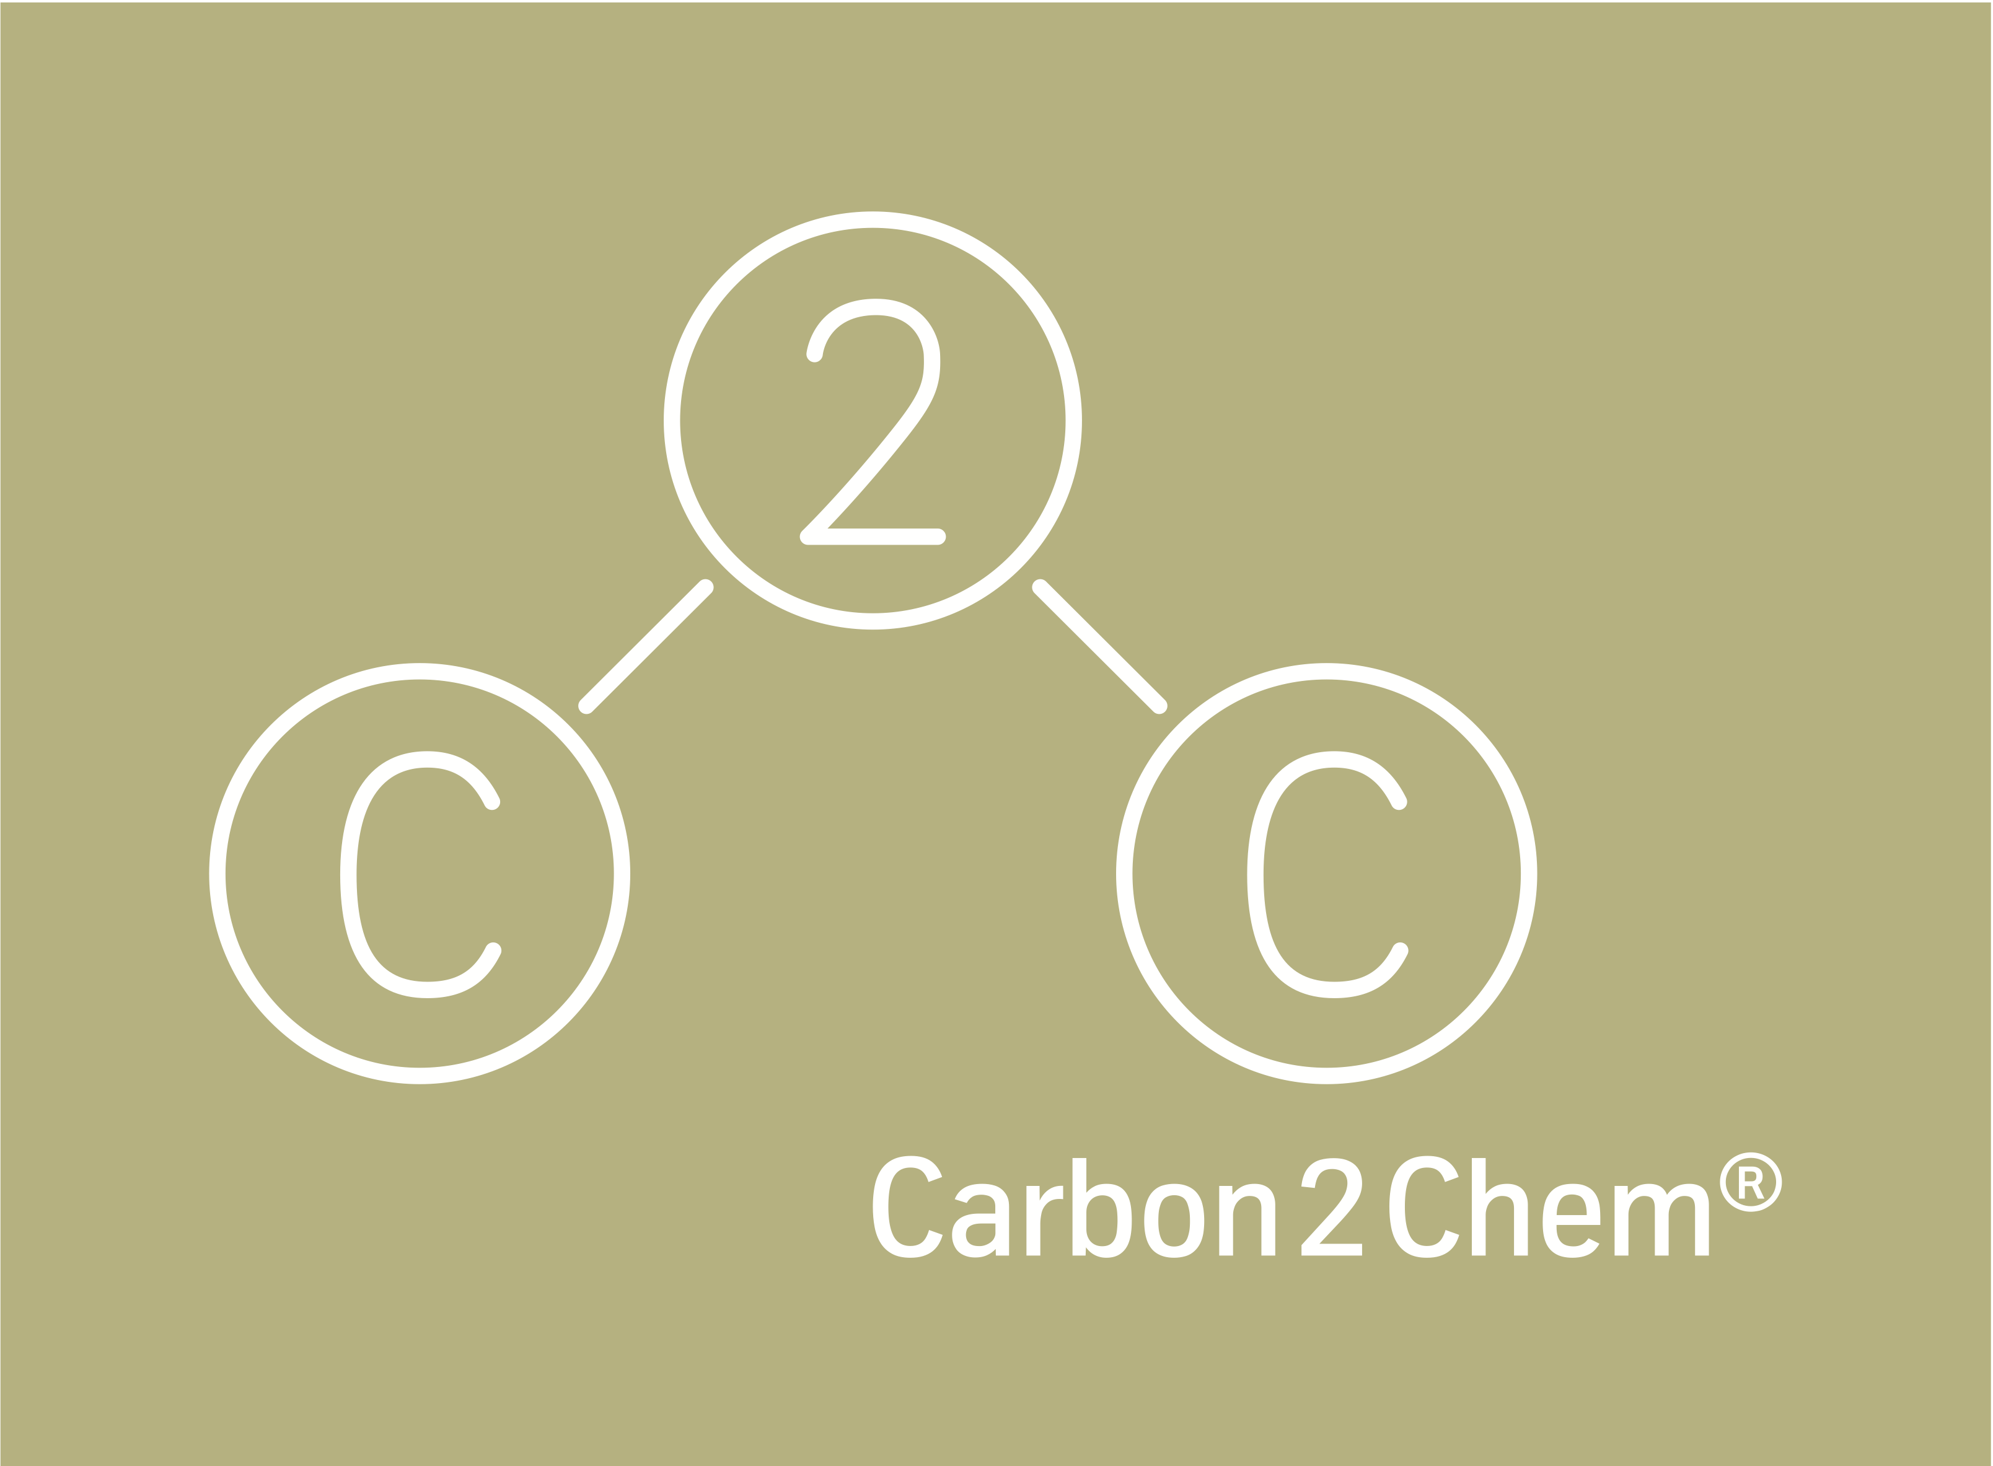
A pathfinder for solar refinery
In Carbon2Chem 18 industries and 5 academic partners form a cross- industrial and cross-disciplinary network.
Collaboration in 5 thrusts.
Lead by system modelling and integration.
Task: Reduce emission of steel making by converting tail gas with RES to a suite of chemical products.
Flexibility with RES abundance and markets for chemicals.
Dimension: 2.5 10⁵ t CO₂ p.a avoidance.
Pilot plant works.
Full scale in planning.

Slide 9
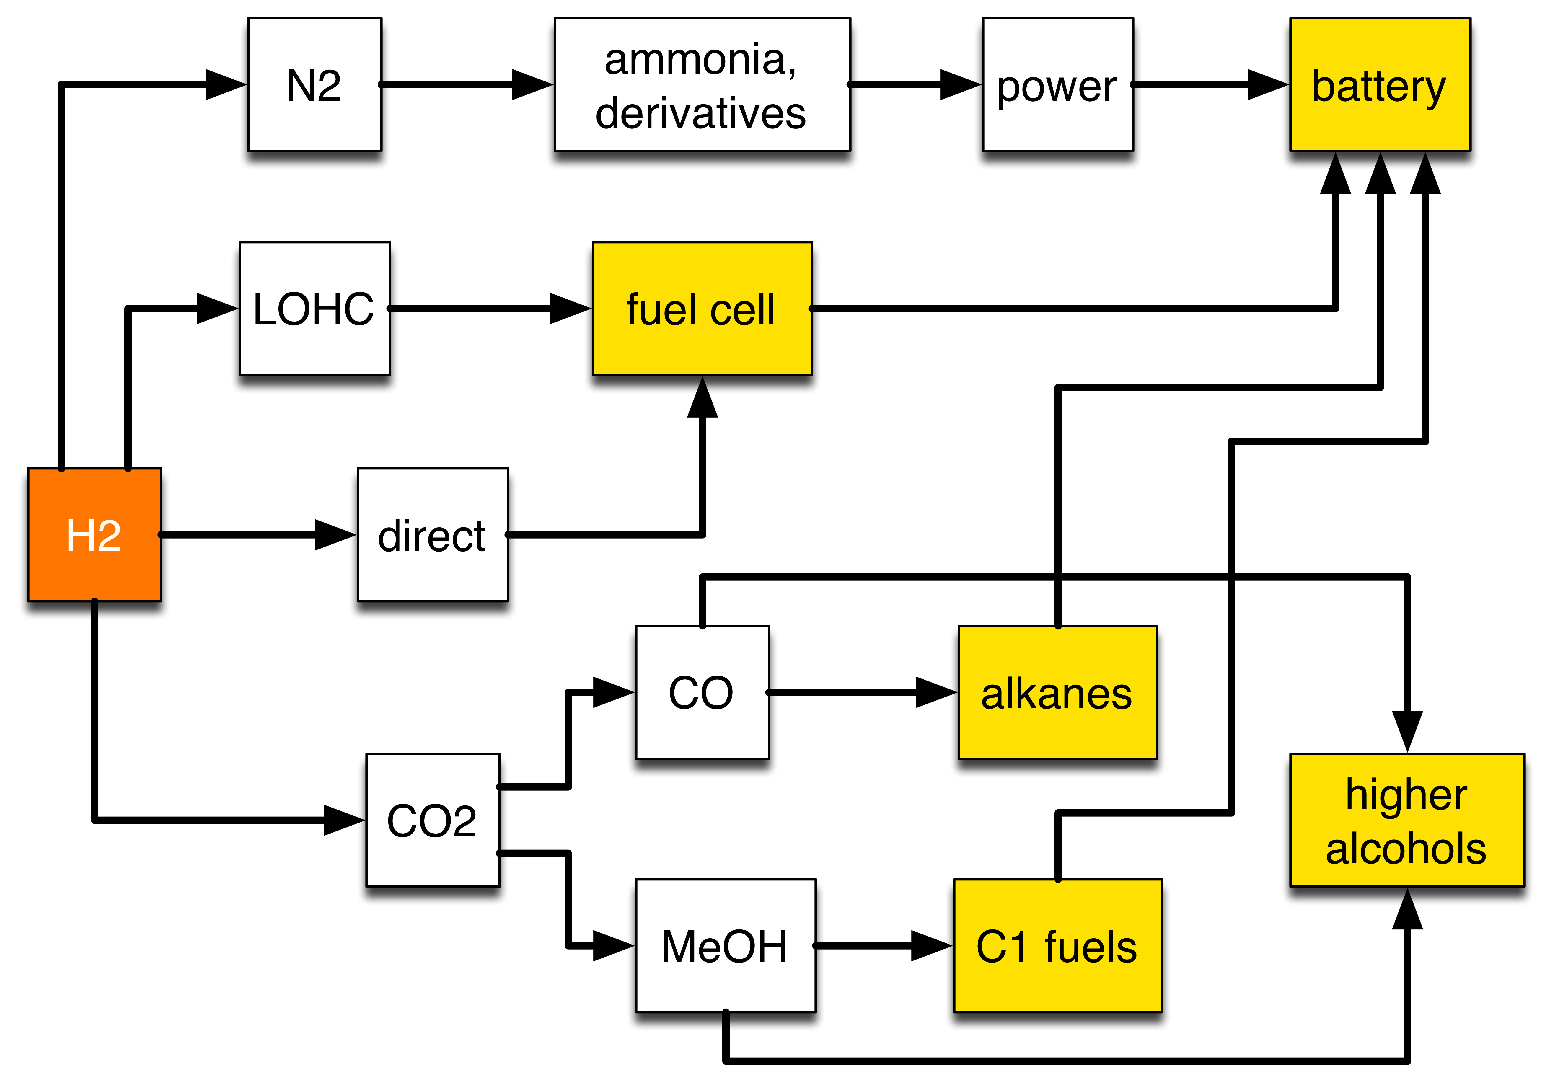
“Solar” or syn fuels: a toolbox
Hydrogen as primary chemical energy conversion product storing RES.
Different chemical structures for different mobility applications (light duty, heavy duty).
Optimized combustion developments for syn fuels are required to avoid the emission of novel toxic substances.

Slide 10
The electrolyser: Mind the dimensions
Take 4 TWh RES for syn kerosene production via MeOH.
Yields 10⁹ m³ H₂, consumes 4.2 10¹¹ g CO₂ and delivers 3.52 10⁵ t MeOH.
Kerosene as C₁₀ H₂₀ idealized results in 1.1 10⁹ mol or 1.5 10⁵ t.
The lower heating value of this equals to 0.155 MtOE.
For the 4 TWh project a hydrogen production of 1.14 10⁵ Nm³/h is needed.
The largest electrolyser in the world is at Aswan dam and produces 3.3 10⁴ Nm³/h.

Slide 11
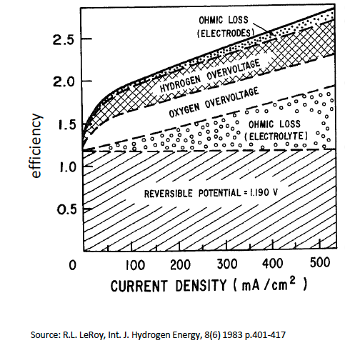
Research options with technical electrolysers
The design is optimized considering the hydrodynamics and the available materials.
The resulting U-I curves reveal that the electrolyte and the cell body design exert the largest contribution to loss.
High temperature electrolysis and the PEM technology will yield a breakthrough provided they can be scaled.

Slide 12
The consequence of electricity use
Grid mix D
Making syn fuels with German or European grid mixes generates more CO₂ than it absorbs!
To reach useful CO₂ reduction factors exclusively RES must be used: in Europe intermittent flexibility operation for ca. 2500 FLH is possible: import!
Dynamic operation of processes is one challenge.
Source: Artz et al ;
Chem Rev. (2018)

Slide 13
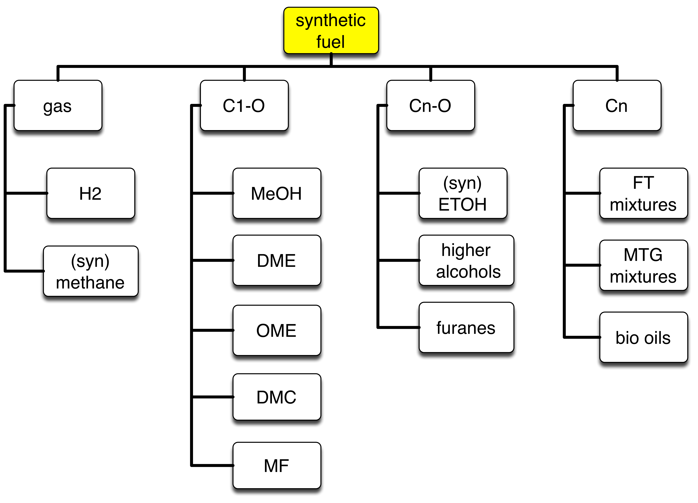
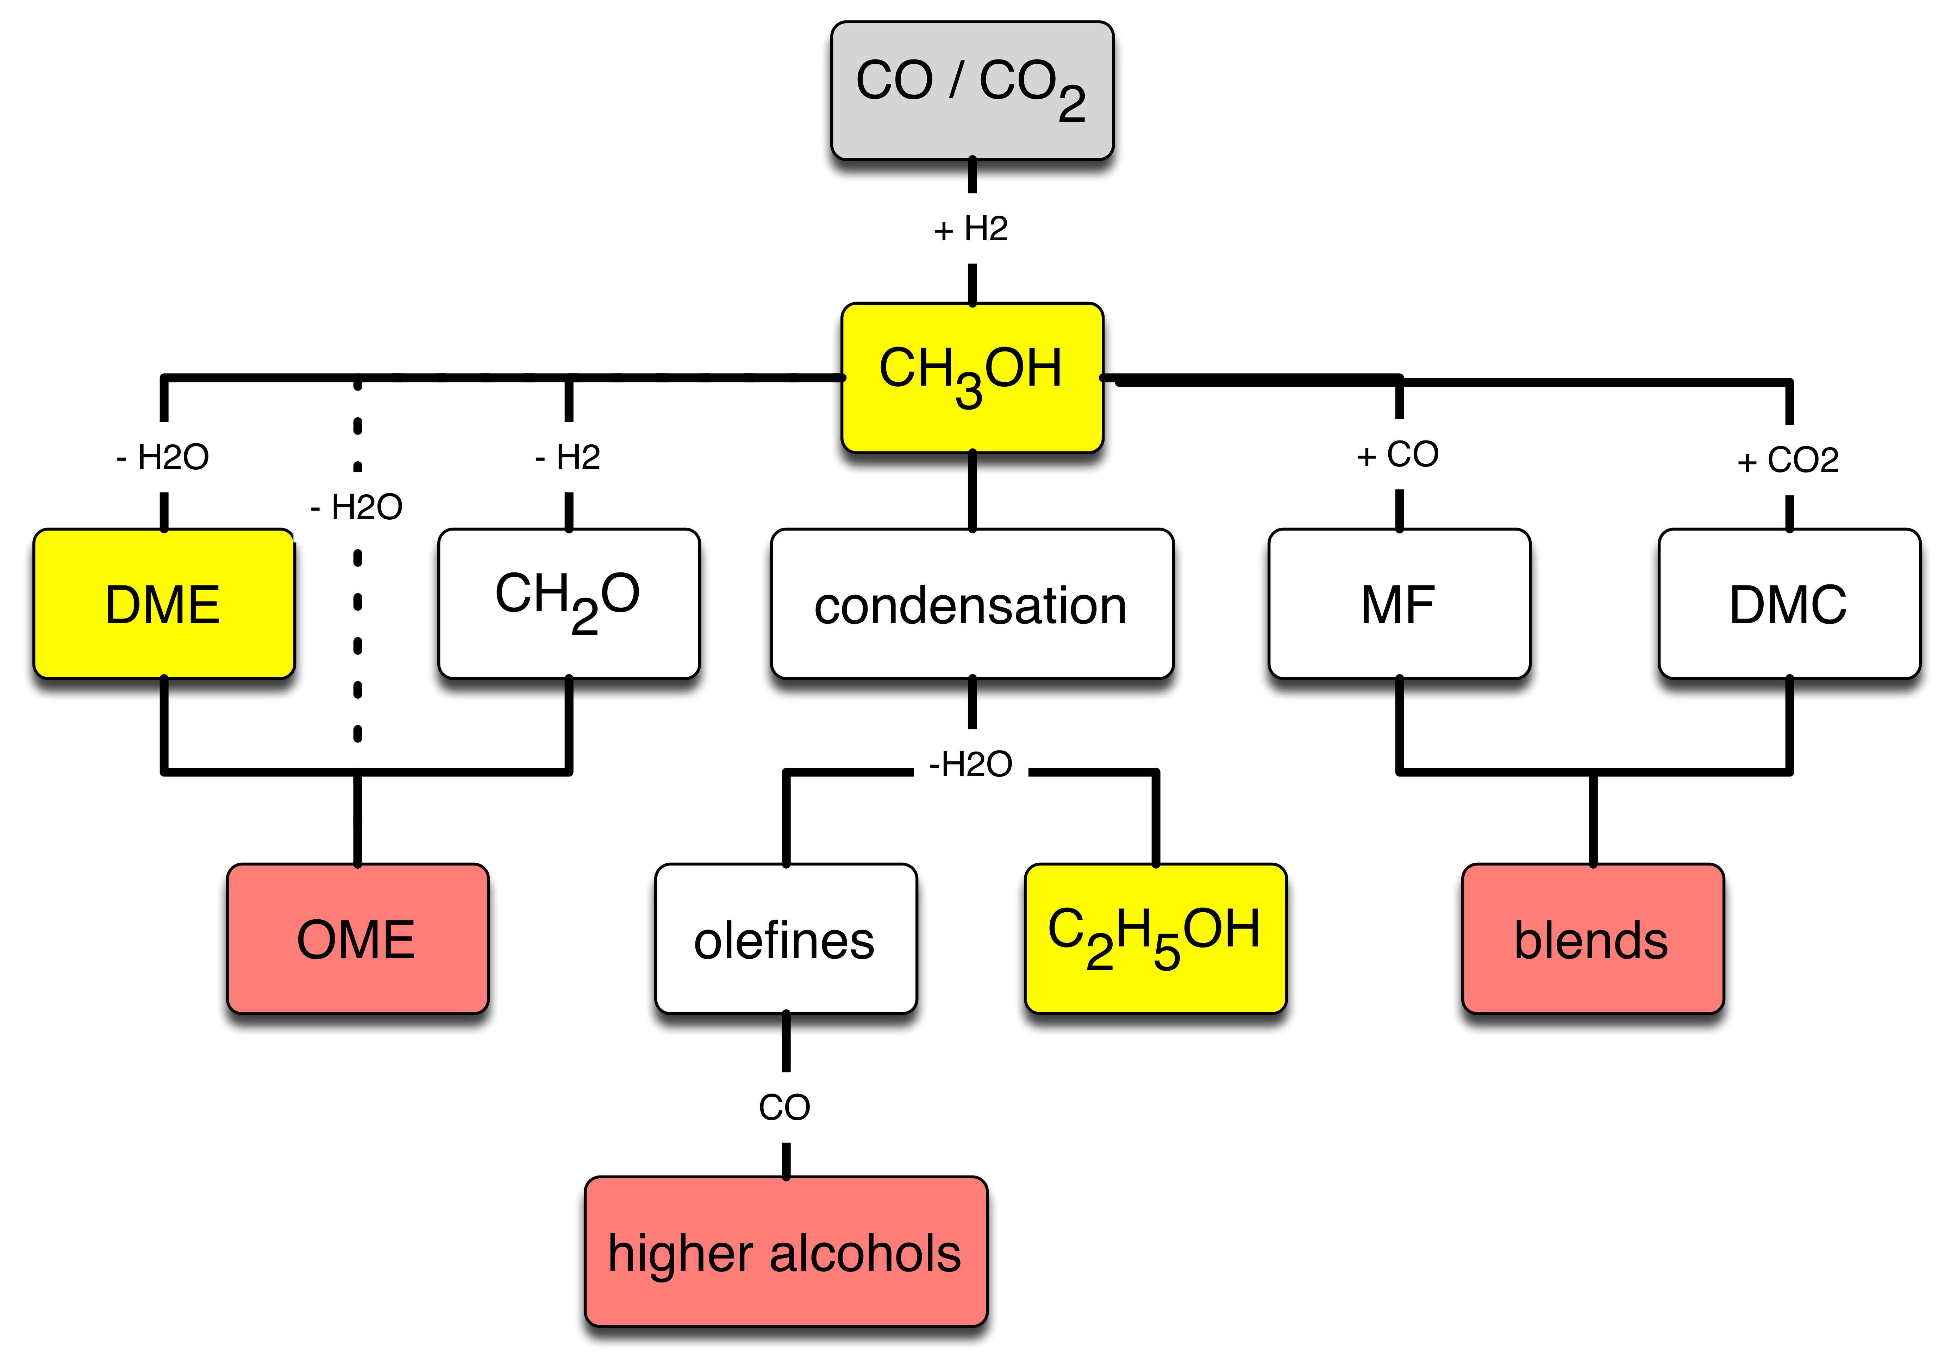
A system of syn fuels
multiple sources of syn gas
fossil, biogenic, waste
homogeneous oxygenated fuels with varying energy density

Slide 14
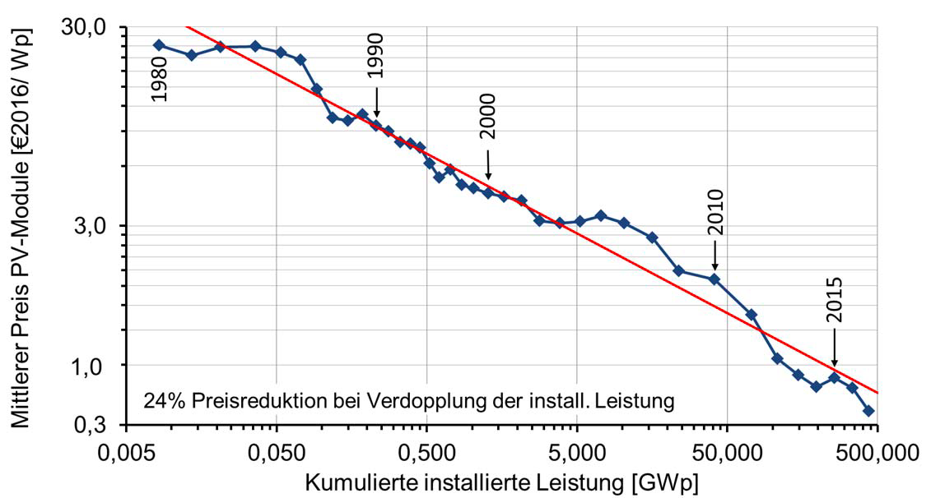
Reservations against syn fuels
For Syn fuels max 50% CO₂ emission reduction potential: “double counting”.
Inherent “RES wasteful” due to process chain length.
Only CO₂ saving if high RES grade energy supply (not now in any local energy system).
Direct hydrogen eliminates several reservations needs new infrastructure throughout Europe.
Source ISE (2018)

Slide 15
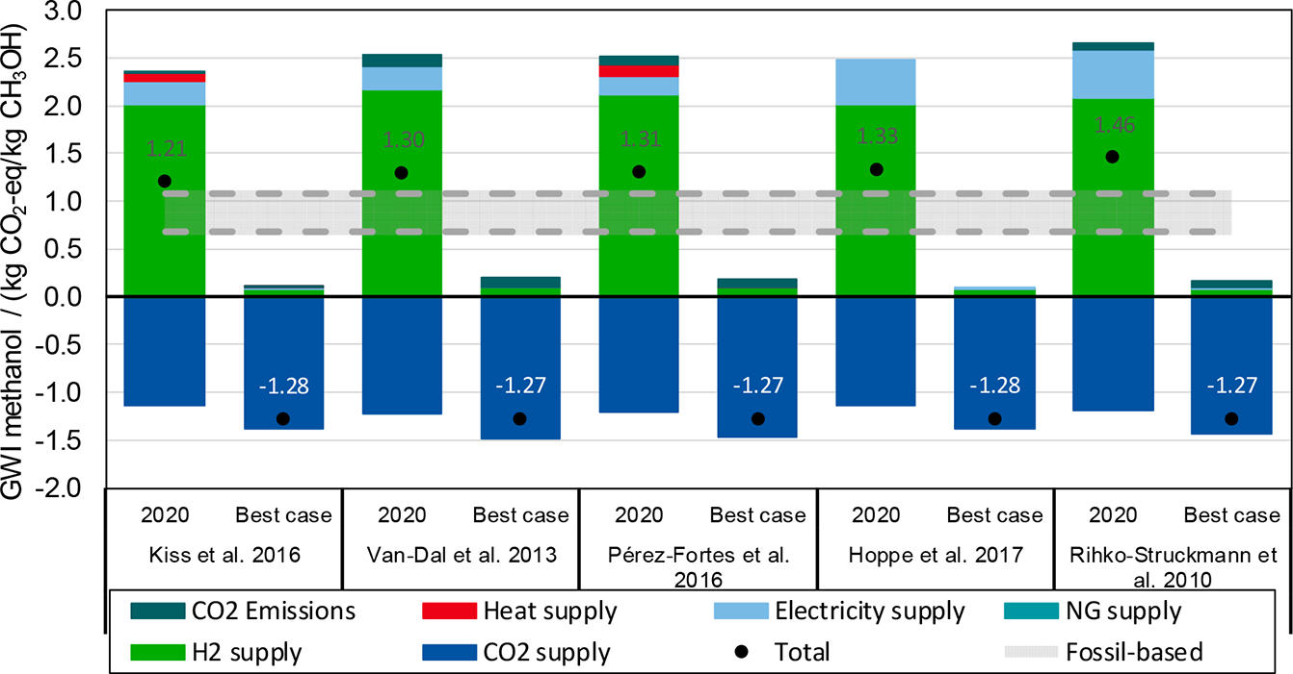
Syn fuels must reach 50% CO₂ reduction
Example MeOH synthesis:
Only with green hydrogen and advanced processing technologies this is possible.
Source: Artz et al ; Chem Rev. (2018)

Slide 16
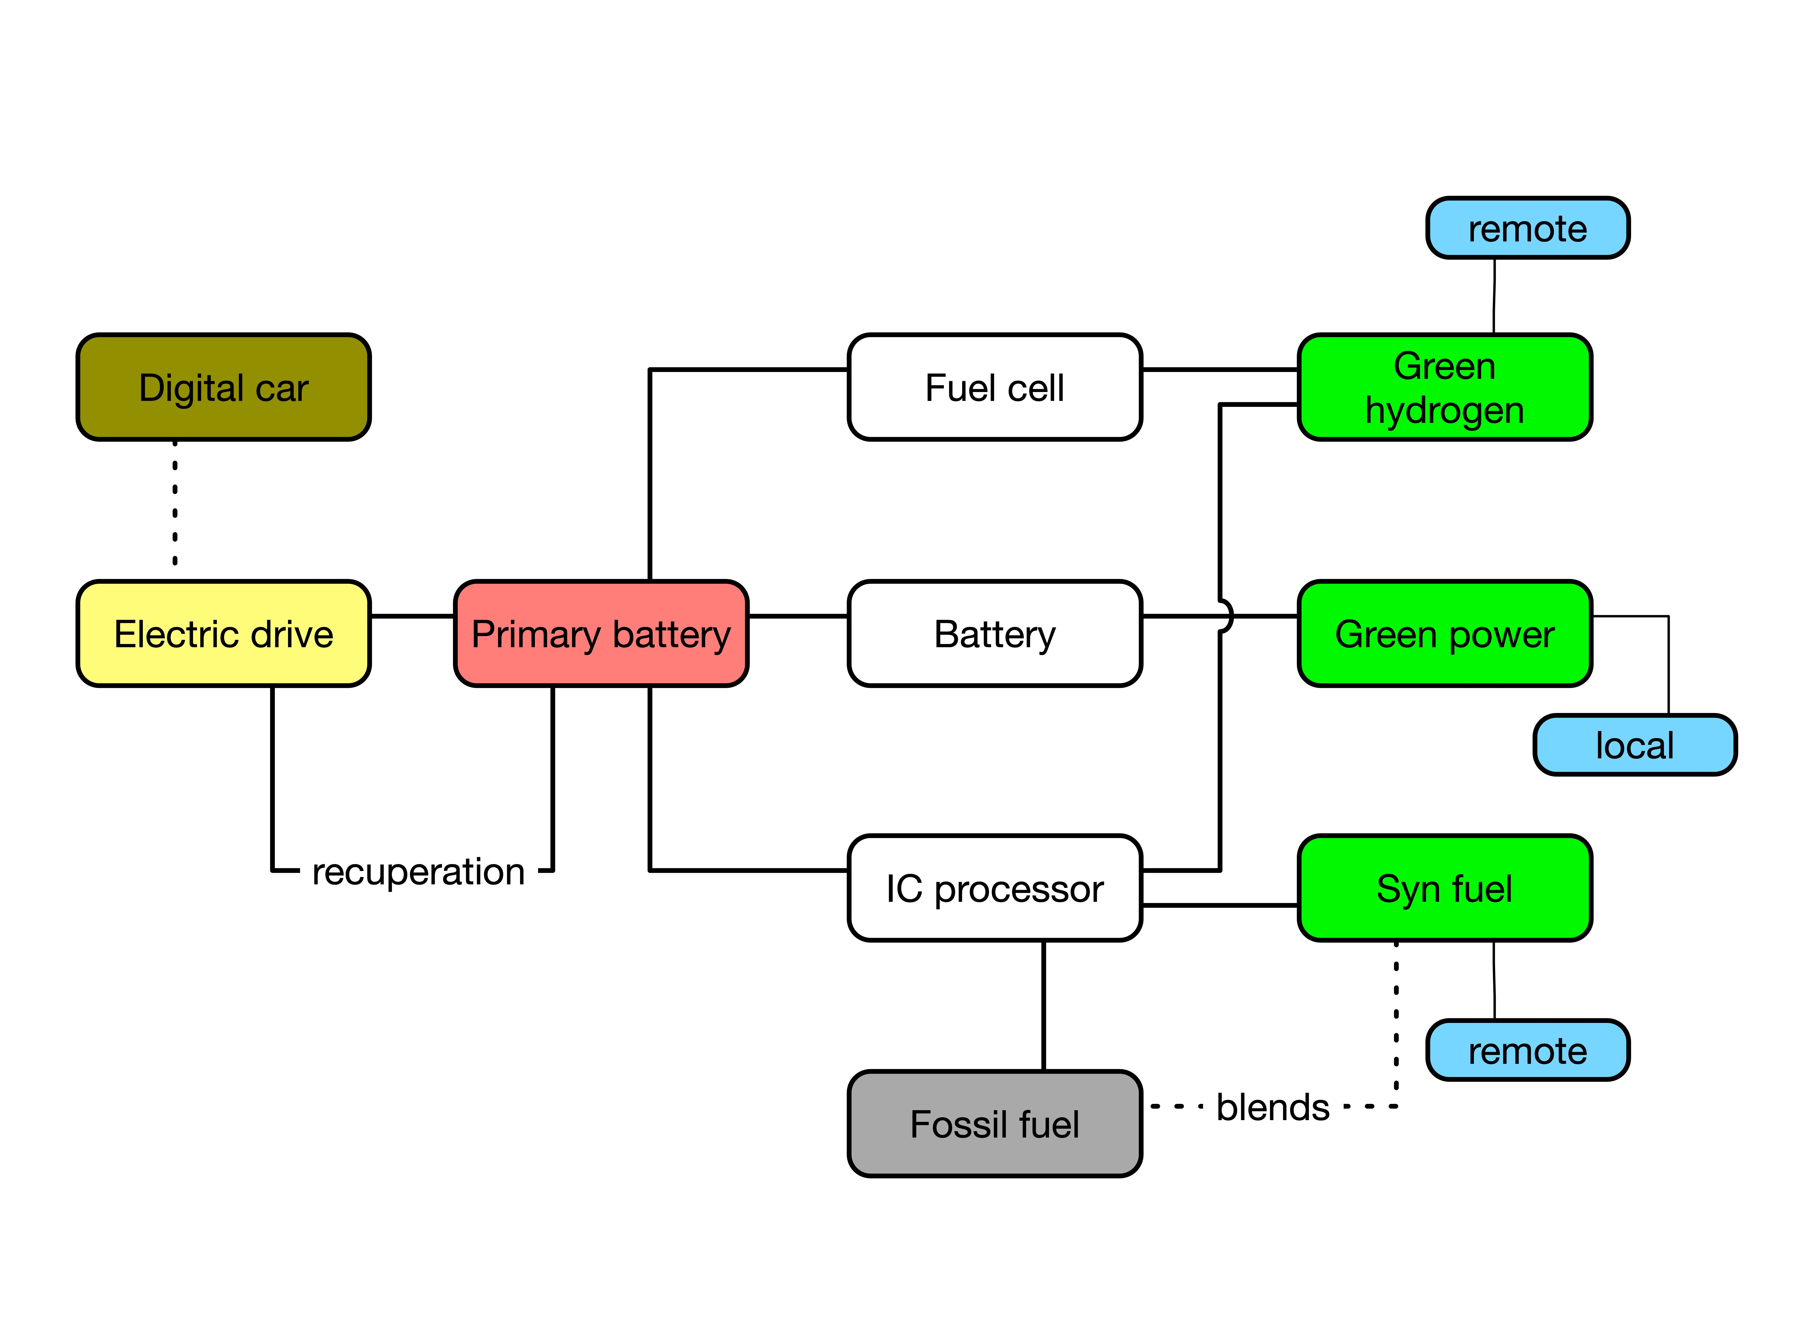
Competition or combination ?
The concept of syn fuels has not taken much attention yet compared to other alternatives.
Can greatly reduce regulated end of pipe emission.
Can greatly reduce mobility footprint in systemic solutions.
Creates little path dependence.
Can integrate existing power train concepts.
Requires cross-industry collaboration.

Slide 17
What should be done (short-term, 2-5 a)
Conceptual clarity:
An all-electric mobility is not a likely concept.
Electric powertrains with multiple options of on-board energy storage is likely.
Syn fuels can work in such solutions as well as in IC- based heavy duty applications.
Adapted chemical structures allow gradual transition of the mobility sector.
Participate in design of the global carbon cycle.
Prepare for a European regional carbon cycle; regulations and infrastructure.
Realize national “real lab” solutions for syn fuels as part of flexibility measures; verify operation models and identify economic framework.
Remove asap regulatory hindrances for such local solutions, identify sites.
Create cross-industrial economic structure; support with cross-disciplinary academic research.
Standardize fuel types and check for technological modifications of IC engines.

Slide 18
Summary
The useful energy system size is Europe and not Germany.
Syn fuels are integral part of a sustainable energy system.
They optimize RES utilization and minimize local emissions with existing technologies.
They induce a minimum of path dependence and utilize much of the existing infrastructure.
Their effect on CO₂ reduction in the mobility system is fast if the dimensional challenge is met.
Beware of double counting, over-planning and accept the unavoidable process inefficiency in exchange of the systemic effectiveness.
Fundamental as well as technological research is still critically required; focus the many activities on suitable priorities.
We are ready to go with G1 of syn fuel application technologies:
get it now on the road.

Slide 19
Dem Anwenden muss das Erkennen vorausgehen
Max Planck
Mache die Dinge so einfach wie möglich aber nicht einfacher
Albert Einstein

